Slide 1








Water is life: Knowing it for a Better Future
WHOW Hackathon
Project partners

Slide 2
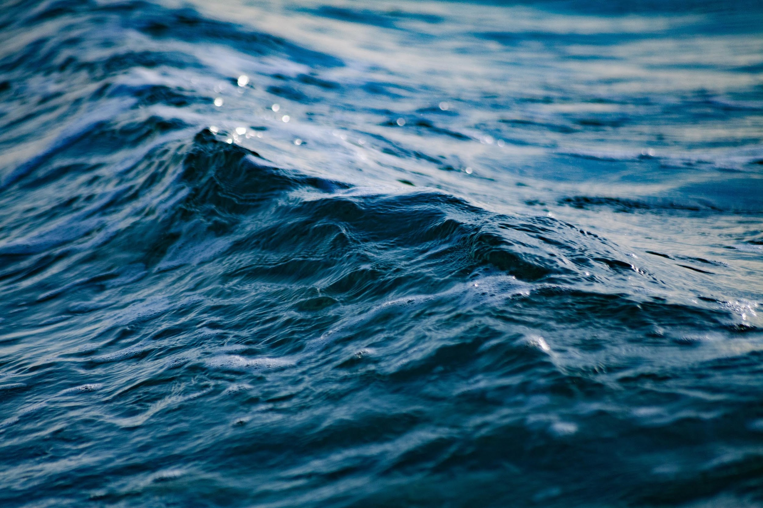
Project and objective
Create the first European open distributed knowledge graph aimed at linking, using a common semantics, data on water consumption and quality with health parameters

Slide 3
Hackathon
Challenges
Data reuse
Developing rest APIs semantically enriched
Multilingualism
Special Challenge

Slide 4
Data reuse
Design or design and development any type of data reuse of your choice (e.g., data viz, maps, standalone applications). A set of pre-defined SPARQL queries will be made available to allow participants to query the knowledge graph and combine data according to their re-usage idea.

Slide 5
Developing
rest APIs semantically enriched
The challenge aims at creating rest APIs, well documented through API schemas that are semantically enriched with the elements defined in the WHOW ontologies and controlled vocabularies. The results are proposed for the inclusion in the Italian national catalogue of semantic assets, schema.gov.it.

Slide 6
To strengthen data re-use and make it more inclusive in an international context, it is crucial to provide multilingual resources. The goal of the challenge is to enrich the current knowledge graph with additional multilingual references, so that the resources can be navigated in different languages. Participants may consider integrating the WHOW's pipeline for the production of Linked Open Data with translation services such as EU-Translation, or DeepL, or others of the participants' choice.
Multilingualism

Slide 7
Special
Challenge
Use your creativity and propose (design or design and implement) anything you want that can enrich or use the WHOW Knowledge Graph!

Slide 8

You can organise yourself into groups to tackle one or more challenges
Hackathon
Organisation
A group is composed of 1 person to many people
The whole day is focused on hacking
Push all software, documentation, and material on GitHub - whow-project/hackathon

Slide 9
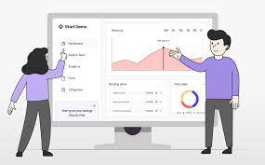

At the end of the day each group will be asked to present the results
Prizes
Each challenge will have a winner*
* A plaque award plus advertisement on institutional and social channels

Slide 10
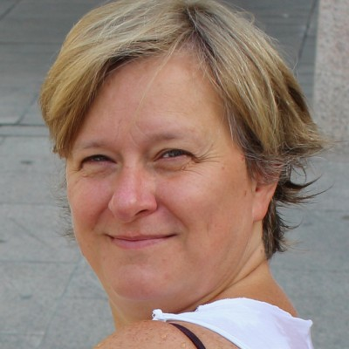
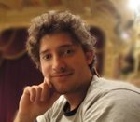

Evaluation
jury
Silvia Castellanza
(Comune di Milano)
Francesco Osborse
(Kmi - The Open University, UK and University of Milano Bicocca)
Marco Cortella (Engineering Ingegneria Informatica)

Slide 11
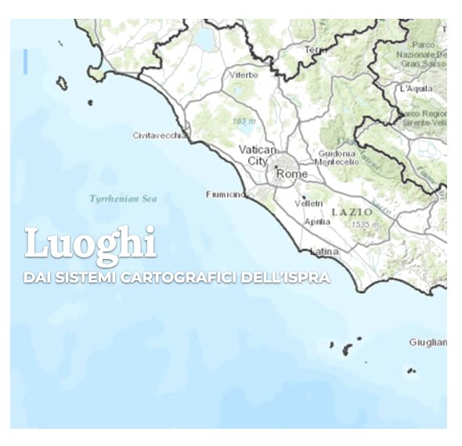
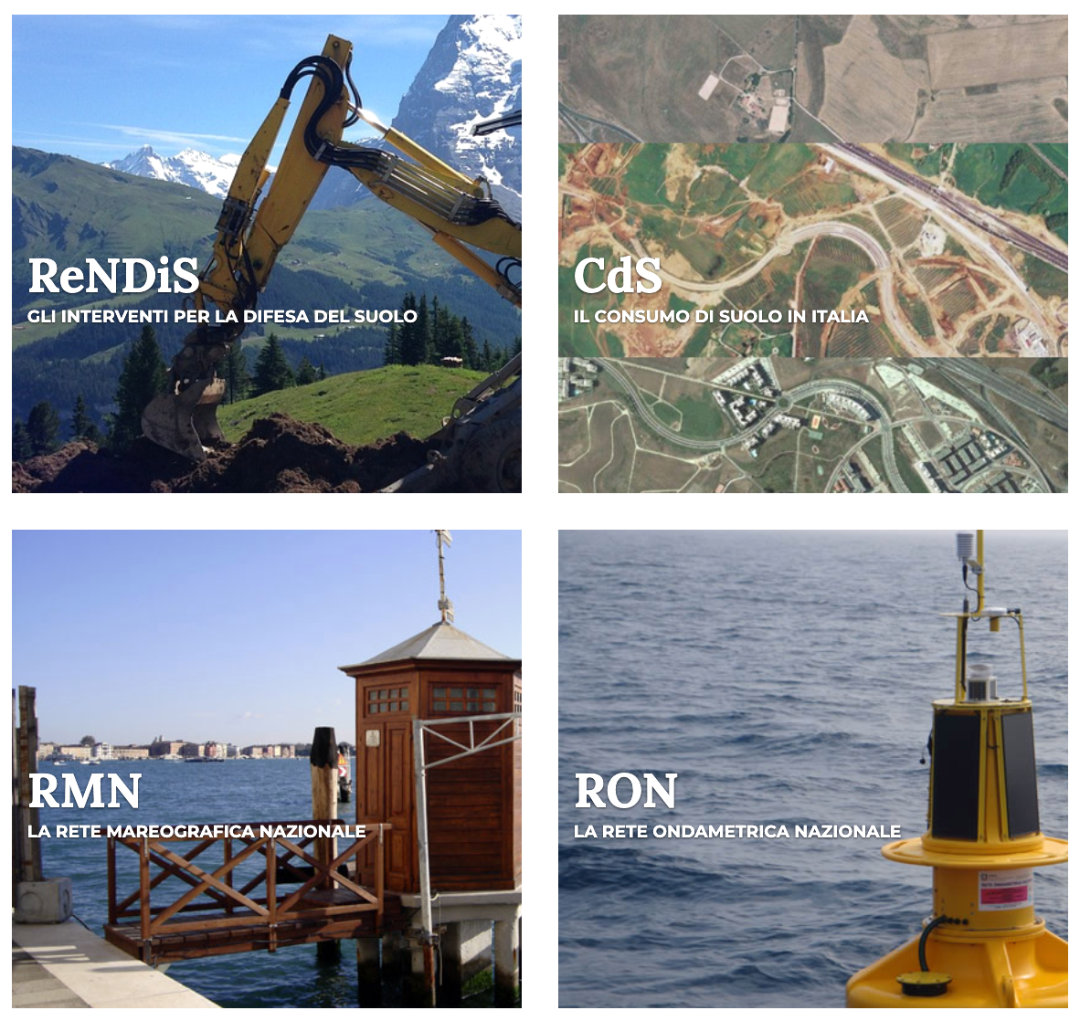
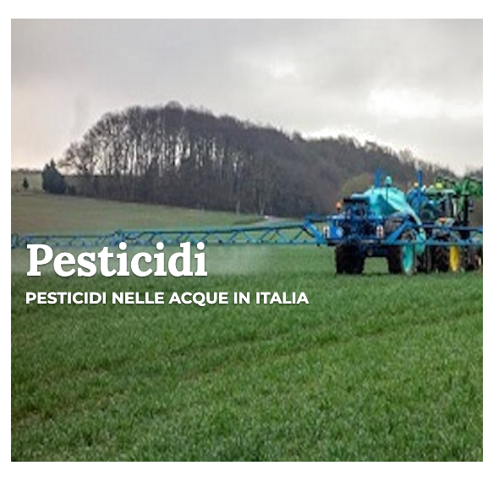
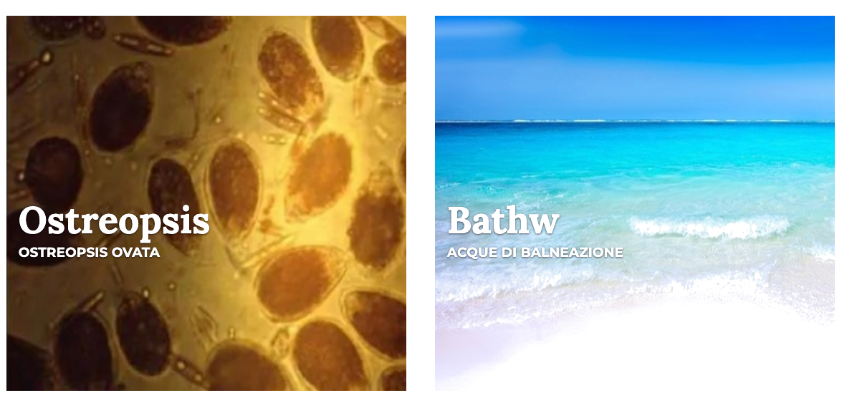

Datasets
provided by ISPRA
https://dati.isprambiente.it/en/

Slide 12
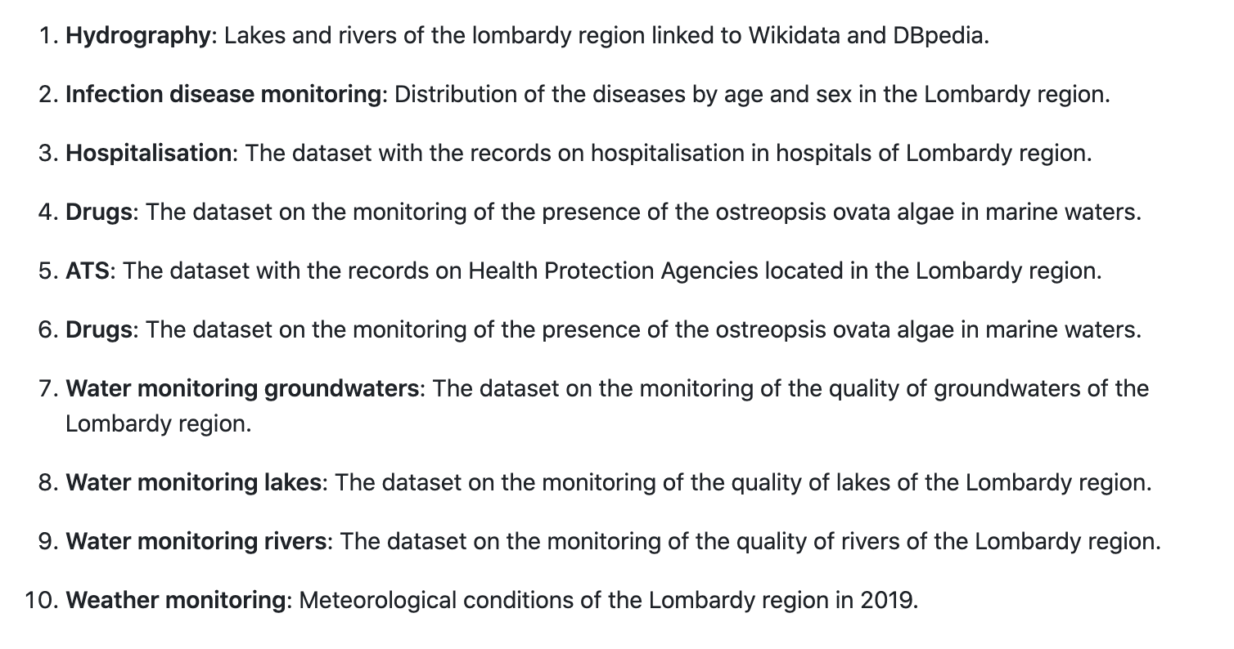

Datasets
provided by
ARIA
https://github.com/whow-project/datasets

Slide 13
The datasets are linked to other international and national knowledge graphs:
Wikidata and DBpedia (e.g., rivers, lakes, chemical substances, biological agents)
ArCo from Ministry of Culture (i.e., cities, provinces, years)
LEO (Livestock Environment Open Data) (i.e., chemical substances)
ISPRA LOD and ARIA LOD are connected with each other (e.g., years, cities)
OntoPiA (i.e., provinces and alignment at the level of ontologies)
Infectious diseases are linked to SNOMED-CT
Linking to the Web of Data

Slide 14
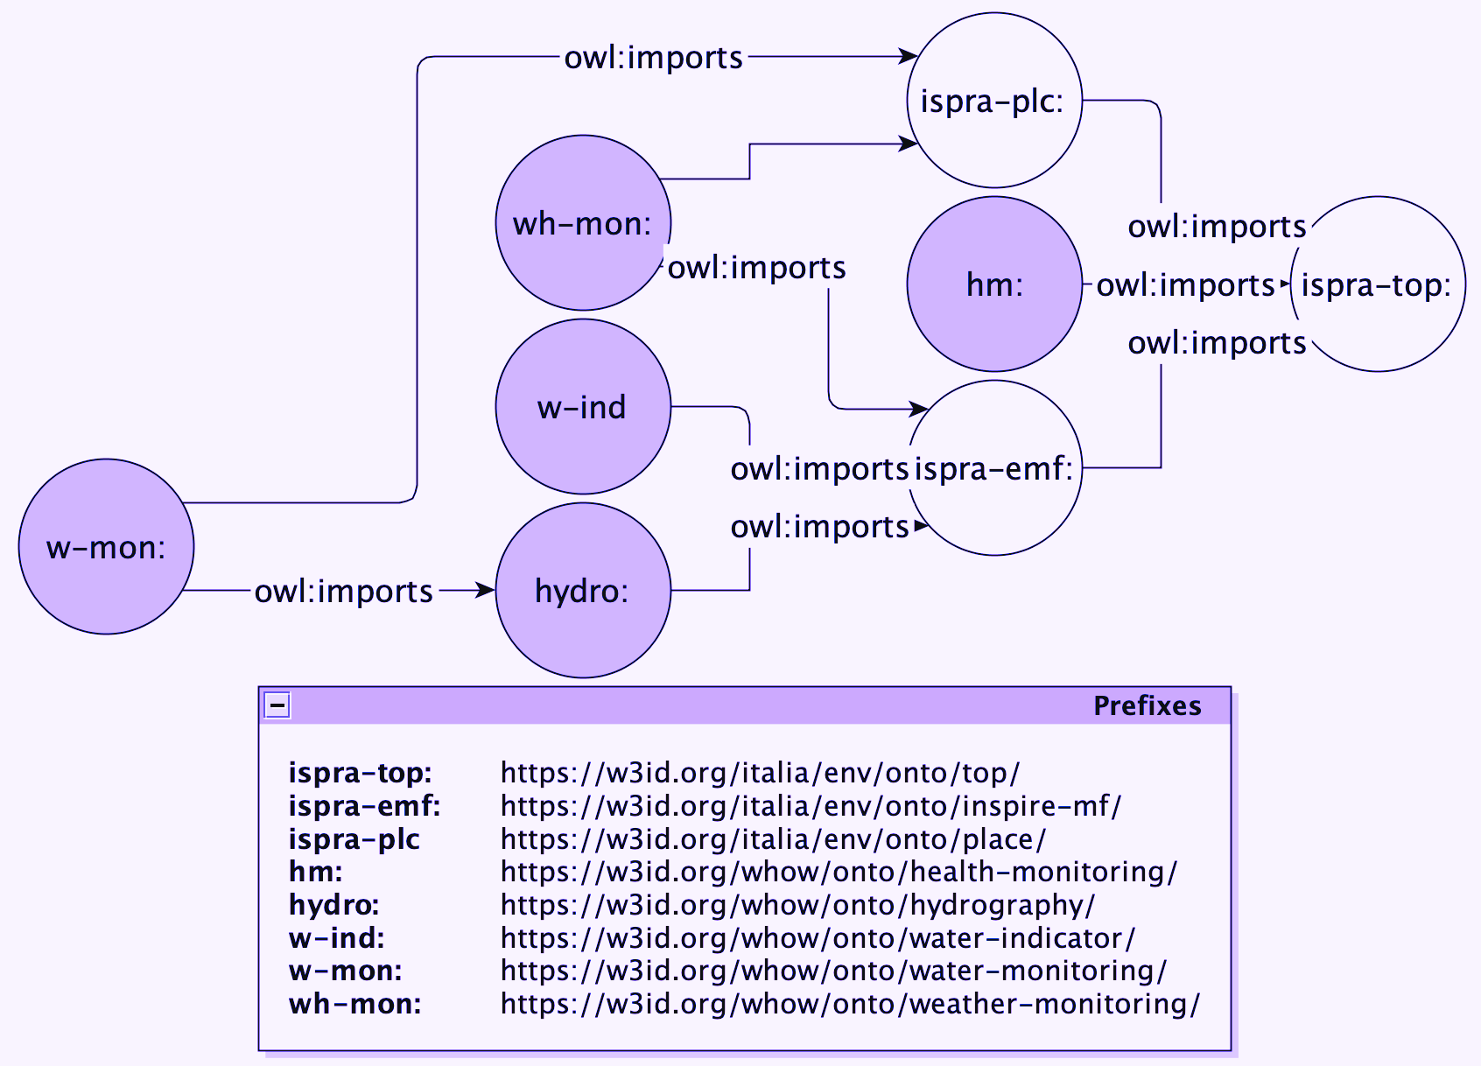

Knowledge
Graph
Schema

Slide 15

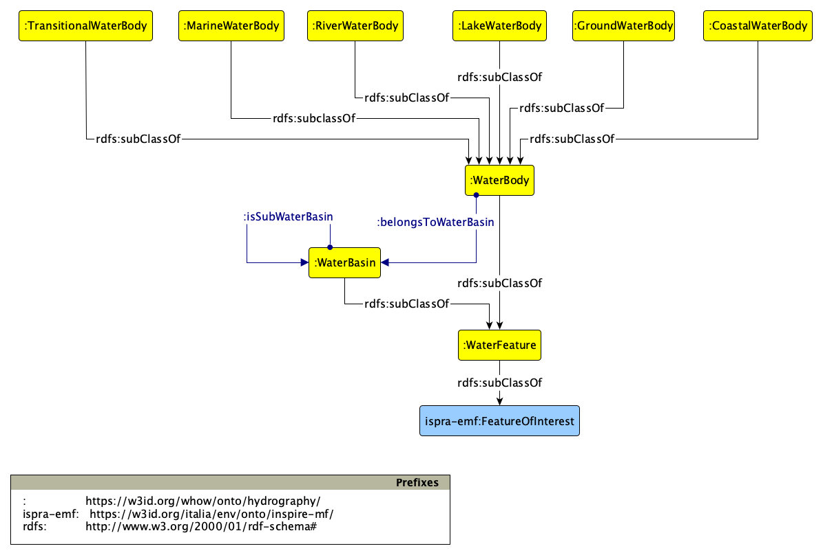
Hydrography ontology

Slide 16
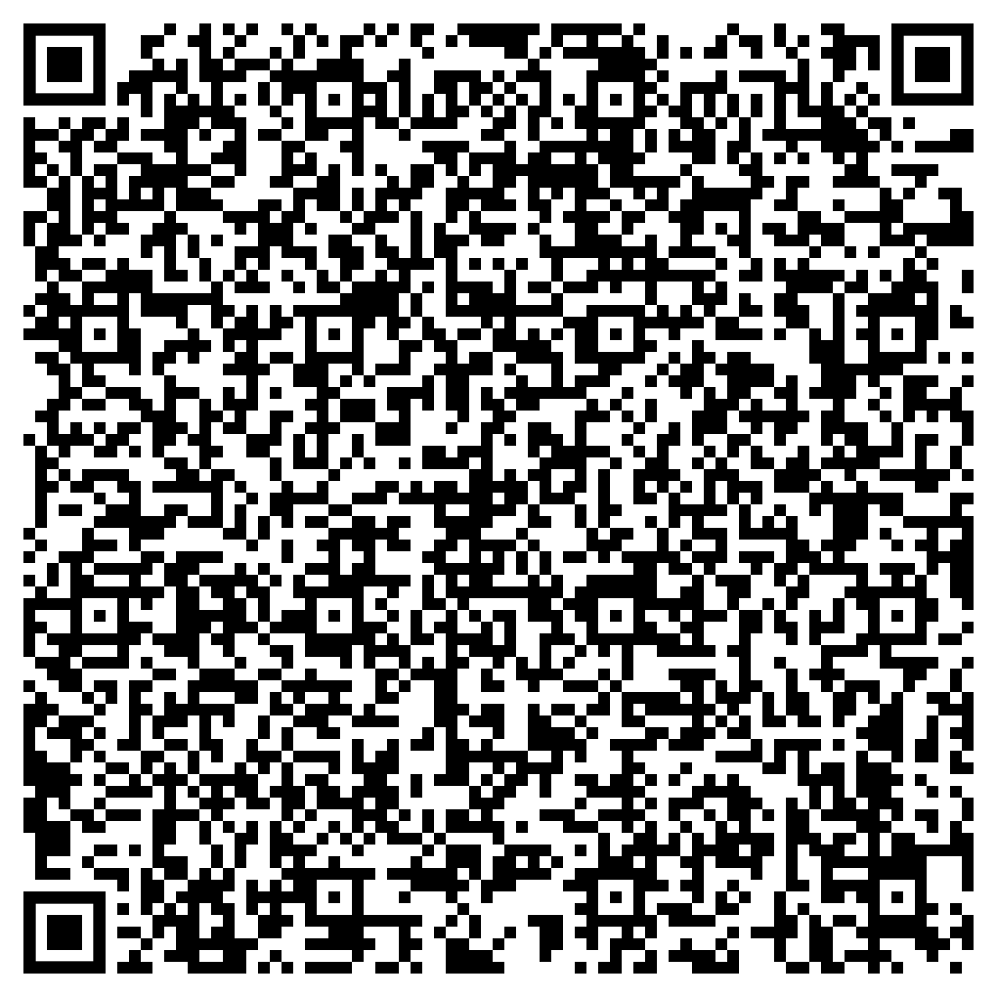
What are the marine water bodies?
PREFIX hydro: <https://w3id.org/whow/onto/hydrography/>
PREFIX emf: <https://w3id.org/italia/env/onto/inspire-mf/>
PREFIX rdfs: <http://www.w3.org/2000/01/rdf-schema#>
SELECT ?mwb ?label
WHERE{
?mwb a hydro:MarineWaterBody;
rdfs:label ?label
}
Try it on https://dati.isprambiente.it/sparql

Slide 17
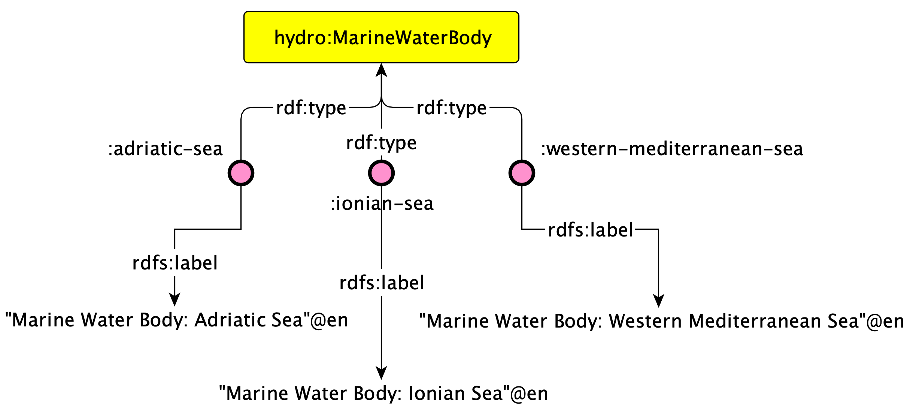
What are the marine water bodies?

Slide 18
What are the water bodies?

Slide 19

What are the water bodies?
PREFIX hydro: <https://w3id.org/whow/onto/hydrography/>
PREFIX emf: <https://w3id.org/italia/env/onto/inspire-mf/>
PREFIX rdfs: <http://www.w3.org/2000/01/rdf-schema#>
SELECT ?mwb ?label
WHERE{
?mwb a/rdfs:subClassOf* hydro:WaterBody;
rdfs:label ?label
}
Try it on https://lod.dati.lombardia.it/sparql

Slide 20
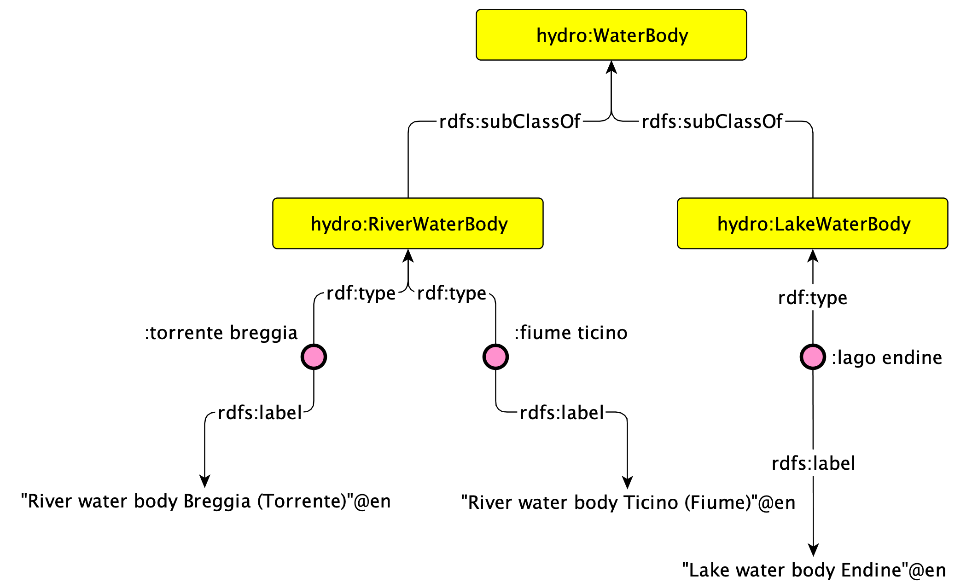
What are the water bodies?

Slide 21
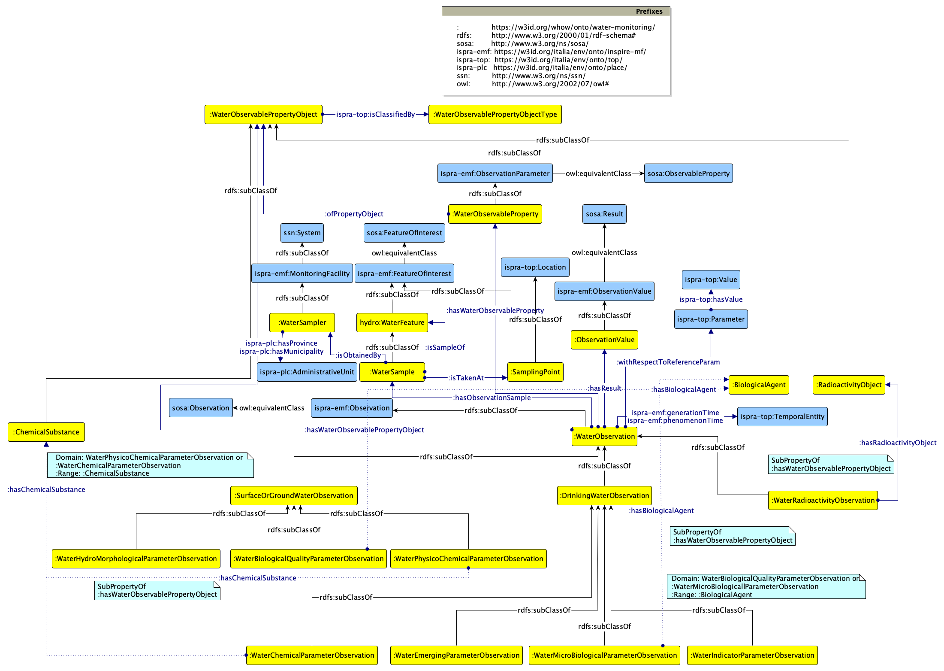
Water Monitoring ontology

Slide 22

What is the concentration of reactive silicates observed for the lake Endine?
PREFIX hydro: <https://w3id.org/whow/onto/hydrography/>
PREFIX emf: <https://w3id.org/italia/env/onto/inspire-mf/>
PREFIX top: <https://w3id.org/italia/env/onto/top/>
PREFIX wm: <https://w3id.org/whow/onto/water-monitoring/>
PREFIX data-lwb: <https://w3id.org/italia/lombardia/data/lake-water-body>
PREFIX data-op: <https://w3id.org/italia/lombardia/data/observable-properties>
SELECT ?obs ?time ?value ?unit
WHERE{
?obs a wm:WaterPhysicoChemicalParameterObservation ;
emf:hasFeatureOfInterest data-lwb:endine ;
wm:hasWaterObservableProperty data-op:1344-09-8 ;
wm:hasResult/top:value ?value ;
wm:hasResult/top:hasUnitOfMeasure/top:name ?unit ;
emf:generationTime/top:time ?time .
}
ORDER BY ?time
Try it on https://lod.dati.lombardia.it/sparql

Slide 23
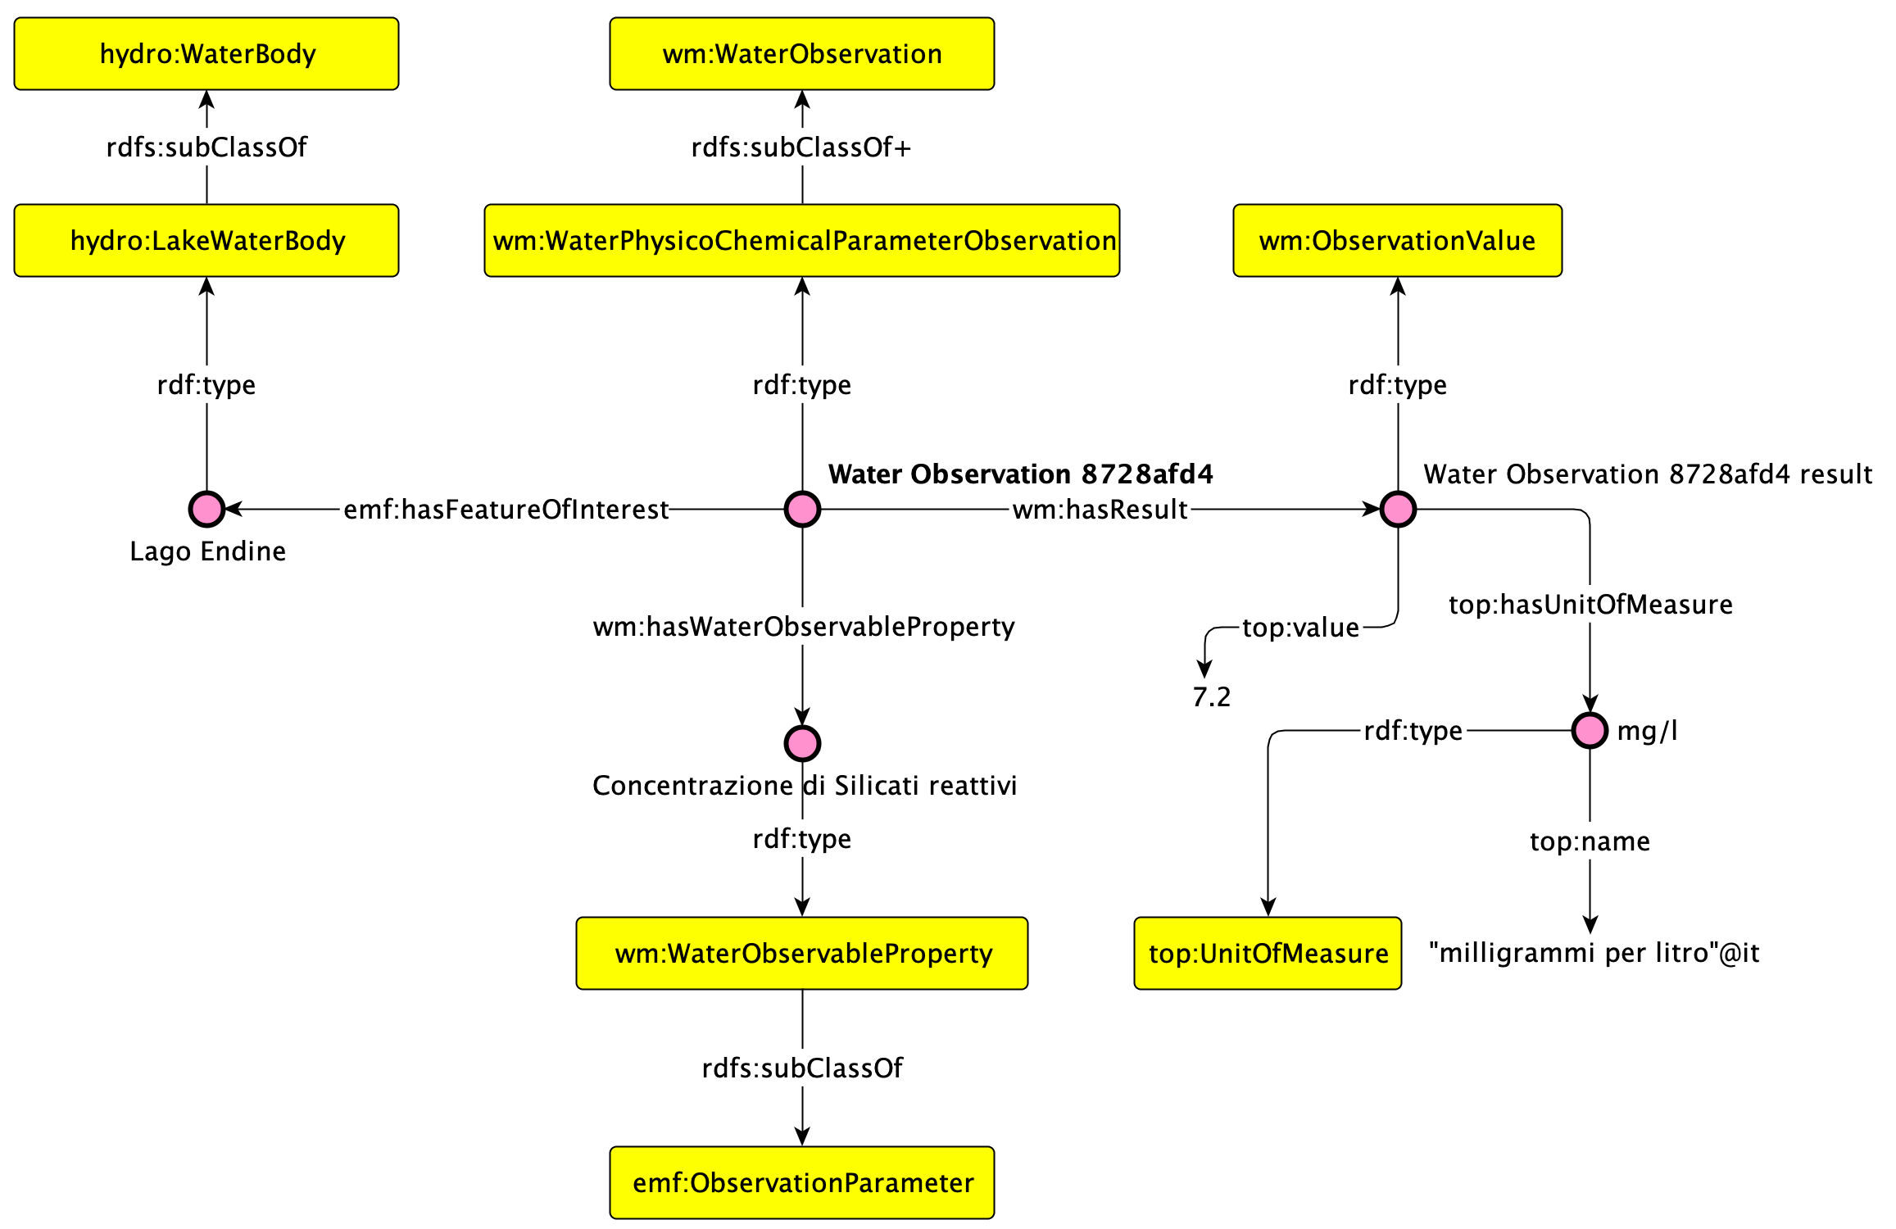
What is the concentration of reactive silicates observed for the lake Endine?

Slide 24
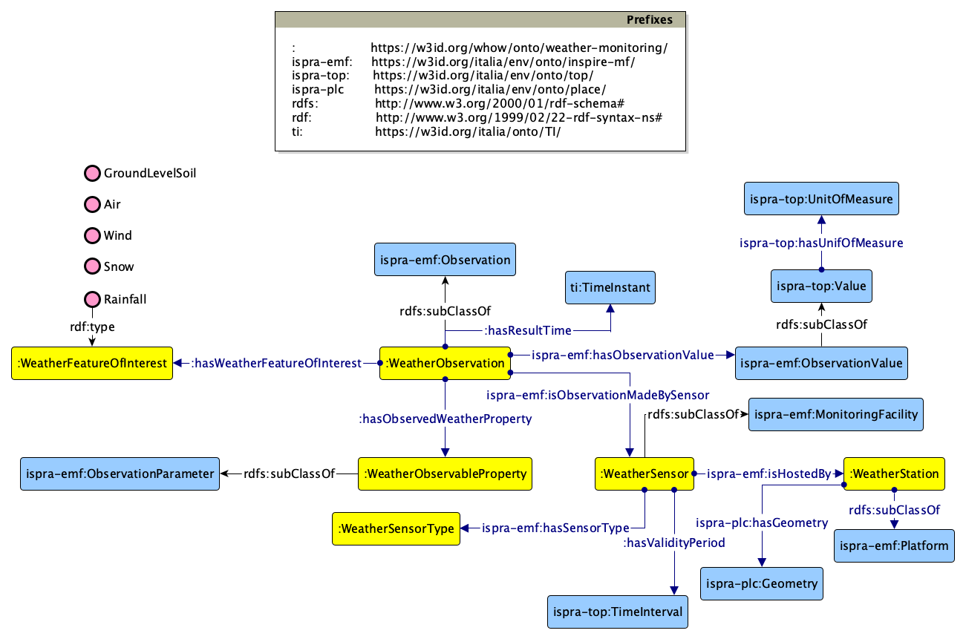
Weather Monitoring ontology

Slide 25
What are the observation generated by Sensor 15?
PREFIX hydro: <https://w3id.org/whow/onto/hydrography/>
PREFIX emf: <https://w3id.org/italia/env/onto/inspire-mf/>
PREFIX top: <https://w3id.org/italia/env/onto/top/>
PREFIX wh-mon: <https://w3id.org/whow/onto/weather-monitoring/>
PREFIX sensor: <https://w3id.org/italia/lombardia/data/weather-sensor>
PREFIX data-op: <https://w3id.org/italia/lombardia/data/observable-properties>
SELECT ?observation ?property ?feature ?time ?value
WHERE{
?observation wh-mon:isObservationMadeBySensor sensor:15 ;
wh-mon:hasObservedWeatherProperty ?property ;
wh-mon:hasFeatureOfInterest ?feature ;
wh-mon:hasResultTime ?time ;
ispra-emf:hasObservationValue ?value .
}
Try it on https://lod.dati.lombardia.it/sparql

Slide 26
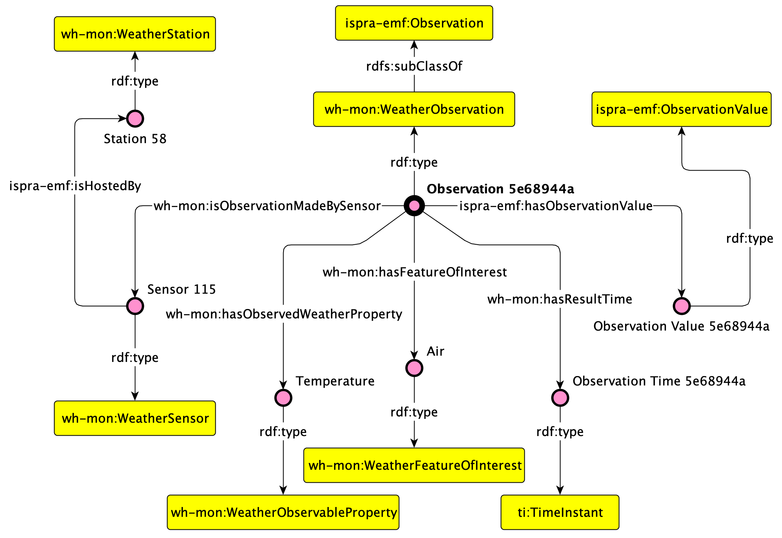
What are the observation generated by Sensor 15?

Slide 27
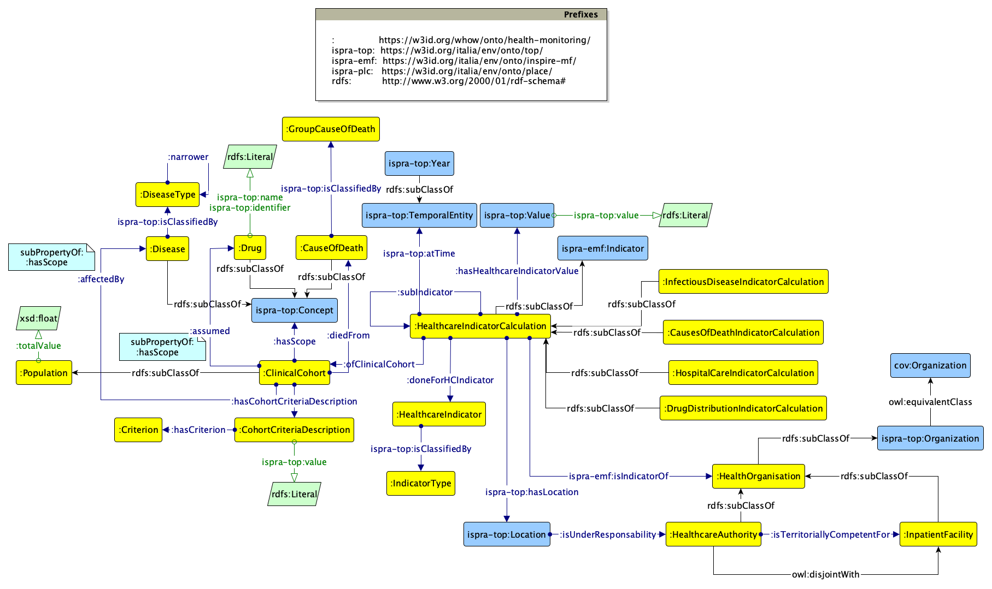
Health Monitoring ontology

Slide 28

What is the average number of accesses recorded by Hospital Macchi during 2016 for digestive tract diseases?
PREFIX ispra-top: <https://w3id.org/italia/env/onto/top/>
PREFIX hm: <https://w3id.org/whow/onto/health-monitoring/>
PREFIX indicator: <https://w3id.org/italia/lombardia/data/indicator/>
PREFIX org: <https://w3id.org/italia/lombardia/data/inpatient-facility/>
PREFIX disease: <https://w3id.org/italia/lombardia/data/disease-type/>
SELECT ?calc ?value
WHERE{
?calc a hm:HospitalCareIndicatorCalculation ;
hm:doneForHCIndicator indicator:average-total-number-access ;
ispra-top:isIndicatorOf org:030901-01 ;
ispra-top:atTime/ispra-top:year "2016"^^xsd:gYear ;
hm:hasHealthcareIndicatorValue/ispra-top:value ?value ;
hm:ofClinicalCohort/hm:affectedBy disease:9
}
Try it on https://lod.dati.lombardia.it/sparql

Slide 29
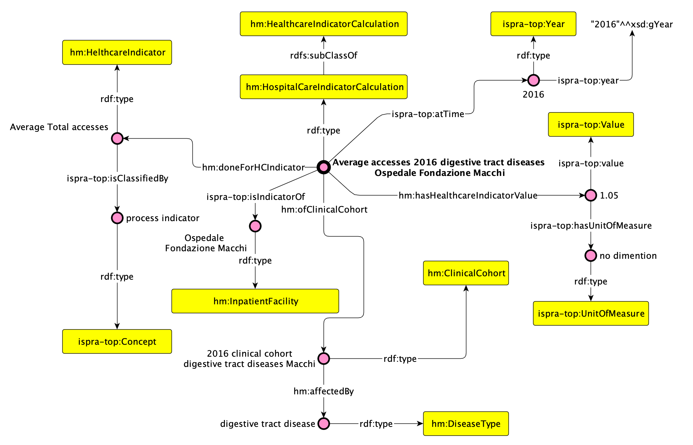
What is the average number of accesses recorded by Hospital Macchi during 2016 for digestive tract diseases?

Slide 30
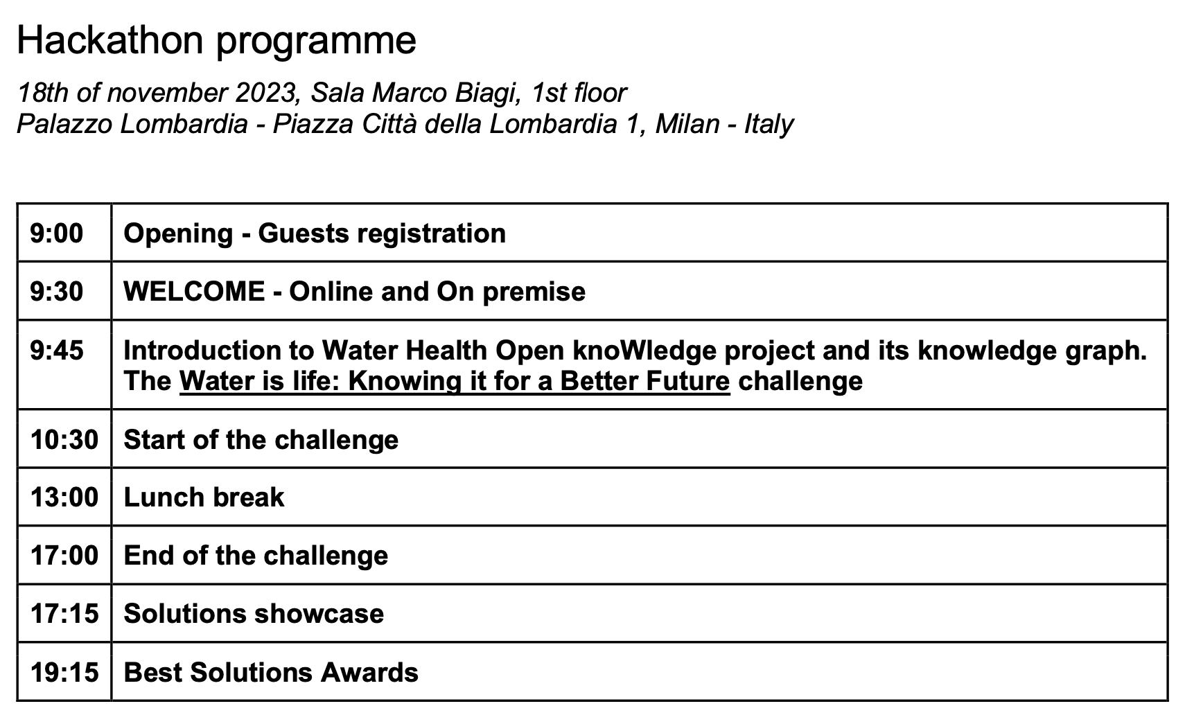
Programme

Slide 31





For more information
TECHNICAL REPORTS
ONTOLOGY NETWORK
GITHUB REPOSITORY
CONTACT US
info@whowproject.eu
whowproject.eu
@whowproject
WHOW Open Knowledge

